Slide 1
SERFF Modernization Project Update
Fall National Meeting
December 2023
Orlando, Florida

Slide 2
Project Overview & Update

Slide 3
Drivers for Change
Operational Efficiency
Product Complexity & Innovation
Technological Advances

Slide 4
Key Capabilities for Modernized Platform
User Managed Customizations
Filing Preparation and Submittal
Consistent and Efficient Filing Review
Communication and Collaboration Tools
API Integration with Business Partners and NAIC Products
Workload Management
Robust Search and Reporting

Slide 5
Phases 1 and 2 – Complete!
GOAL
Address pain points in existing system while building foundational components for new platform.
Improve search
Introduce Tableau

Slide 6
Search Improvements Delivered
Data Search
15-20x faster
New search criteria
Easily combined with document search
Document Search
Better results – includes scanned PDFs, supports phrase search, virtually eliminated stop words
Faster results – from minutes long and time outs to average of .5 seconds
Increased usage - Available to all users with no adverse performance impact
Foundational Components
OpenSearch Index takes load off operational data stores
Search API integrates with application and public portal
Monitoring ensures stability and responsiveness

Slide 7
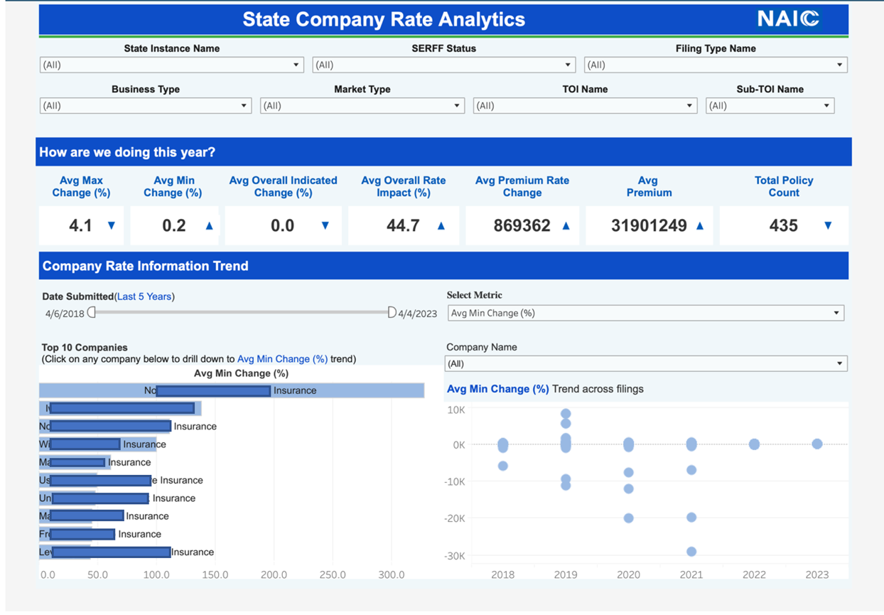
Tableau Dashboards in Production
Providing more than ‘just data’
For Regulators
Filing & Form Metrics
Objection Metrics
Filing Company Metrics
Reviewer Analytics
Company Rate Analytics
For Industry
Filing & Form Metrics
Productivity Analytics

Slide 8
Project Timeline
2024
Q2
Interstate Compact
User Management
2024
Q4
Life/Annuity/Credit
2025
Q3
Property & Casualty
2025
Q4
Health
2026
Q3
Plan Management

Slide 9
Platform Development Update

Slide 10
Development Completed
Product Coding Matrix & TOI Groups
State Business Rule Module
Streamlined Filing Creation
License Verification
Pre-Submission Check
Form Number Extraction
Form Type Classification
Internal Notes
Filing Contacts
Improved Company Data
Search
Customizable Dashboard
Task Management
Quick Browse
Annotations
Self Service User Management

Slide 11
In Progress & Upcoming
“Objection” Process
Changing terminology
Better tracking and reporting
Ability to reissue
Fees
80% of fee scenarios calculated by system, including retaliatory fees
Filer will have override and self calculation options
Reporting and monitoring to improve rules
End User Reporting
Expanded Document Compare
Email notifications

Slide 12
Data Initiatives
Historical filings will be migrated to the new platform
Fit into new structure without loss of meaningful data
Draft filings will not be migrated
Only compact filings first release
Data from new platform moving to NAIC’s Enterprise Data Warehouse for Tableau
Data access tools, including API, in the works

Slide 13
Machine Learning

Slide 14
Use Cases for SERFF
Form Schedule Extraction and Classification
Help
Interactive Checklists – prevent compliance issues vs just helping to identify them
Correspondence Assistance
Statement of Variability
Document Similarity
Enhanced validations

Slide 15
Our Approach
Choose the right tools
Experiment
Develop best practices
Support states in building sustainable processes

Slide 16
Outreach

Slide 17
Outreach in 2023
Three NAIC National Meetings, five state visits, three company visits
Presentations for AICP, LHCA, APCIA and the Insurance Summit
Monthly PSC calls averaging over 100 attendees
Regulator Workshop
Attendees from 41 states and territories
Activities included
Product Demo and Q&A
One-on-one consultations
Table topics
Focus groups and numerous other customer interactions

Slide 18
2024 Outreach Goals
Continue all 2023 outreach activities, including additional visits to states and insurance companies
Additional workshops, including a virtual regulator workshop for states unable to attend the October session
Begin training and implementation for Compact release
Begin requirements gathering for Life/Annuity/Credit implementation
Increase awareness across all user and stakeholder groups

Slide 19
Questions?

